Slide 1

London Precious metals Exchange
Analysis on precious metals based
on economic indicators
Notes:
Welcome to our presentations. Here we will be giving advice on which precious metals could be the best to invest in depending on the user’s needs, and whether in some cases precious metals are good to invest in at all.

Slide 2

Our Selected Precious Metals
Gold
Silver
Platinum
Palladium
Notes:
There are 2 types of metals: precious and non-precious. Precious metals are usually more valuable than non-precious metals. This is because of their rarity, how they’re made and found, and their historical roles. Here we have selected the most common precious metals amongst investors: gold, silver, platinum, palladium.

Slide 3

Our Selected Economic Indicators
Inflation (CPI)
Interest Rates (bank of England base rates)
GDP growth %
Notes:
Our selected Economic indicators are inflation, interest rates and GDP growth

Slide 4
On What Grounds Do We Formulate Our Investment Recommendations
Using historical data to predict precious metal prices long term and short term
Economic indicators
(Past and predicted)
Notes:
To offer advice, we analyse short and long-term precious metal price predictions using historical data (1990-2023).
Economic indicators, including inflation, Bank of England interest rates, and GDP, are crucial for predicting future precious metal prices.

Slide 5
Potential Investor Profiles
Short Term Investment
High risk
Low risk
Long Term Investment
High risk
Low risk
Notes:
We’ve focused on giving advice based on potential investor profiles. Hence, we’ve given our advice in terms of short term and long terms investments, as well as high risk and low risk investments

Slide 6

General Relationships Between Economic Indicators And Precious Metal Prices
Inflation
Interest Rates
GDP
Notes:
Based on External research and economic theory, here are some general relationships between EIs and PM prices:
Inflation generally has a positive correlation with gold prices due to it being an inflation hedge.
We also expect inflation to have a positive correlation with silver price as we expect gold and silver to be coupled.
Interest rates tend to affect all pm, and high interest rates cause lower prices as these make other assets more competitive.
Low GDP causes higher prices in precious metals which means that precious metals tend to recover better than other assets.
******(at the end input external links for this)

Slide 7
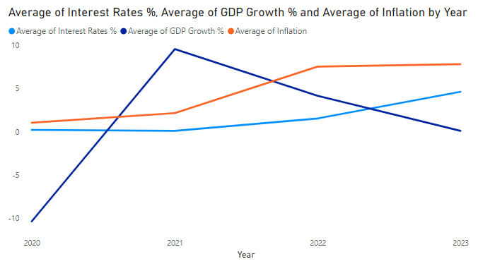
Current Economic Situation In The UK
The UK is currently in an unstable time-period
Stagflation (high inflation and low GDP)
Cost of living crisis (very high energy prices)
Unstable Government (4 prime ministers in 4 years)
Notes:
Let’s look at the current economic situation in the UK:
The UK is currently in an unstable time-period where there is
Stagflation (high inflation and low GDP)
Cost of living crisis (very high energy prices)
Unstable Government (4 prime ministers in 4 years)
All of this has had a huge negative impact on the consumer and business confidence.
****replace graph with the filtered graph of just those years

Slide 8
Expectations
Short term
Long term
Notes:
With the UK being in an unstable time period now, we think precious metal prices might deviate from the expected patterns we explained previously. But in the long term future the market tends to even out, so we think metal prices will follow the expected patterns.

Slide 9
Short Term
Notes:
Now let’s start looking at short term advice – usually short-term investments can vary from a 1 month to 36 months.

Slide 10
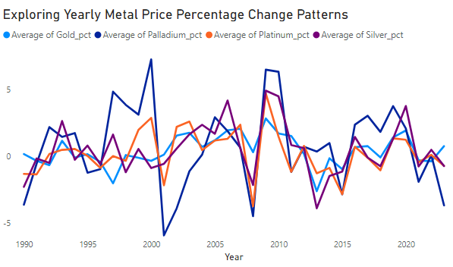
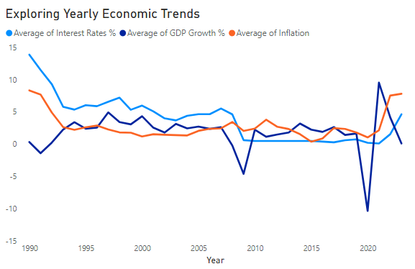
Examining Historical Data: Uncovering Unexpected Correlations Between Economic Indicators and Precious Metal Prices
1990 - 1993
2008
2022 - 2023
Notes:
From our correlation calculations, we can see that:
In 1990, unexpected weak correlations between gold, inflation, and interest rates may be explained by the UK joining the European exchange rate mechanism (ERM) and a recession in 1991, the UK economy later stabilised in 1993.
The 2008 the financial crisis caused a plummet in GDP as well as a shock in the precious metal market among others, the Bank of England responded by cutting interest rates from 5% to record lows of 0.5%, resulting in strong correlations among metals, interest rates, and GDP.
In 2022, high inflation forced the Bank of England into increasing interest rates, causing strong negative correlations between metal prices and interest rates and influencing the weaker correlations between metals and inflation in 2023.
Notably, the rapid rise in energy prices in 2022 (index of 152) compared to the expected 2023 index (112, from a 2010 base of 100) goes some way to explaining this high inflation.

Slide 11
Current Unstable Period
Opportunity For Very High Returns In The Short Term
This Comes With A High Risk
Notes:
From this we can see that for all the years with extreme economic events, there was a very good opportunity for a high return on investments in the short term, but this also came with a very high risk.
Given that we are in uncertain times right now, we expect similar opportunities to arise.

Slide 12
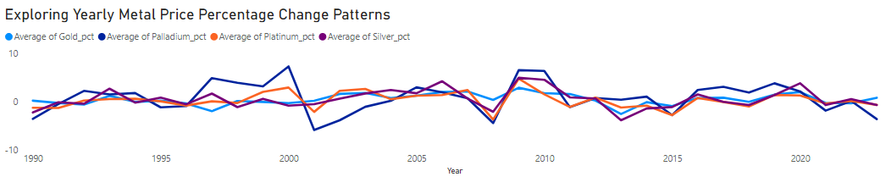
For investors interested in a high short-term return, and are also happy taking a high risk, we would recommend palladium or platinum.
Short Term High Risk Investment Advice
Notes:
A bit of background on volatility: Higher volatility generally means a higher risk as there's a greater chance that the price of an asset moves unexpectedly, which could lead to both larger gains and larger losses.
From our correlations and now our volatility analysis we can see that in general gold has a lower volatility and therefore a lower risk during unstable periods than other metals. This suggests that gold is the safer of the four, however it is still high risk and subject to investor confidence and market conditions in the short term. out of the four, palladium demonstrates the highest opportunity for short term gains however it is also very volatile so associated with the highest risk. This is followed by platinum at second most volatile.
Our advice: For investors interested in a high short-term return, and are also happy taking a high risk, we would recommend a larger palladium or platinum allocation.

Slide 13
For investors looking for more guaranteed gains, we recommend investing in standard Gilts and savings bonds over precious metals.
Short Term Low Risk Investment Advice
Notes:
As shown by the volatility graph, the PM market is quite volatile in the short term. This makes short term investment in PMs risky and a potential investor who is looking for more guaranteed gains is better off investing in other avenues for example, Gilts and savings accounts where your initial investment amount is guaranteed.
Gilts are government bonds where an individual lends to the government for a fixed interest rate. Their initial investment is returned in full.
Our Advice: For investors looking for more guaranteed gains, we recommend investing in standard Gilts or a savings account over precious metals.

Slide 14
Long Term
Notes:
Now let’s look at long term investments which we’ve defined as more than 3 years.
In long term investments generally speaking volatility becomes less relevant as the assets have time to ride the peaks and troughs of the market, making it less risky to invest over a large time period vs a short time period. So when analysing the best assets to invest in over the long term we are focusing more on potential returns. These returns can also be affected by economic indicators.

Slide 15
Metal Price Volatility
Notes:
As we have already shown with our previous volatility calculations gold is the least volatile asset during periods of economic uncertainty however when looking at the volatility of the metals from 1990-2023, we see that silver has the lowest volatility overall, while Platinum and palladium have the highest overall volatilities.
This means that gold and silver are 2 of the least risky investments and have the most stable returns. However, this also means that they can result in much lower returns.

Slide 16
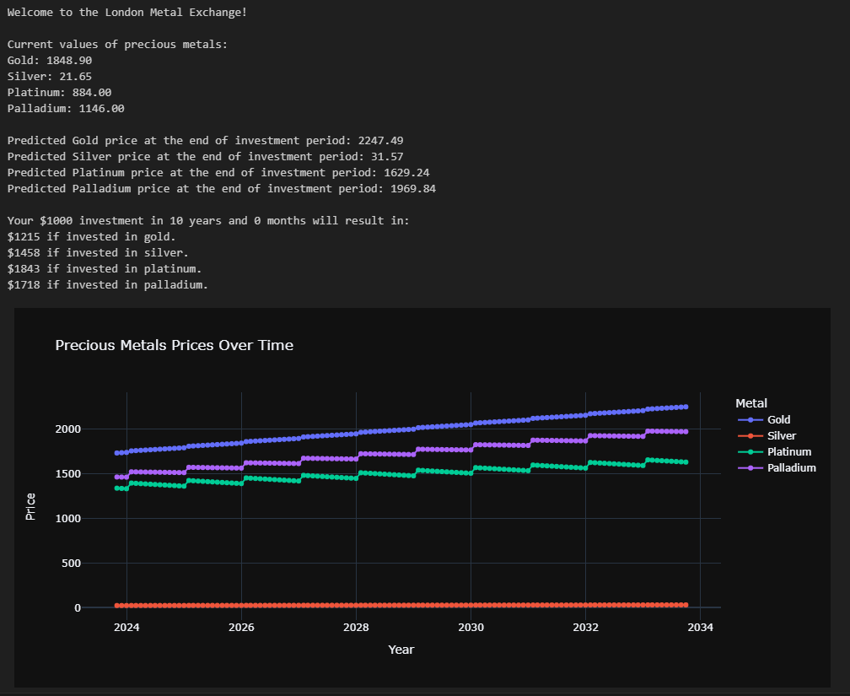
Metal Price Forecast
Example
Your $1000 investment in 10 years will result in:
$1215 if invested in gold
$1458 if invested in silver
$1843 if invested in platinum
$1718 if invested in palladium
Notes:
This is confirmed by our forecast, a $1000 investment for 10 years would yield the lowest return from gold, followed by silver. In contrast, platinum and palladium offer higher returns.
To compare this to a similar market, we looked at the FTSE 100 which increased by 23% in the last 10 years, whereas gold prices increased by around 50% suggesting potential for higher long-term returns with gold investments.

Slide 17

Long Term Investment Investment Advice
Long term investments – all precious metals
Higher risk - higher proportion of your investment in palladium and platinum
Lower risk - higher proportion of your investment in gold and silver
Gold - Inflation hedge and safe haven
Very low risk - long term gilts
Notes:
We recommend people interested in long term investments to consider all precious metals. If you are open to higher risk, we recommend more of your investment to be allocated to palladium and platinum. For lower risk, we recommend more of your investment to be allocated gold and silver. However, note that, gold acts as an inflation hedge and safe haven, unlike other metals affected by technology changes.
For investors looking for very low risk, long-term gilts are available, though with they have much lower returns as discussed before.

Slide 18
Recommendations
Long-Term Investments: Consider diversifying your portfolio with all precious metals for stability and potential growth. Add a mix of low-risk assets discussed before.
Risk Considerations: For those comfortable with higher risk, allocate a higher proportion to palladium and platinum.
Balanced Approach: If seeking a lower risk profile, consider a higher proportion in gold and silver, especially for long-term investments.
Gold's Unique Role: Recognise gold's status as a reliable inflation hedge and safe haven investment.
Low-Risk Options: Explore very low-risk opportunities through long-term gilts or interest linked Gilts. On the short-term savings bonds (accounts) are available.
Crafting a well-balanced investment strategy tailored to your risk appetite and financial goals is key. We're here to assist you in making informed decisions for a prosperous financial future.
Notes:
Let's dive into some key points for a solid overall investment strategy. Here's the breakdown:
Long-Term Investments:
For a robust foundation, consider diversifying your portfolio with all precious metals. It's a smart move for stability and potential growth. And don't forget to mix in those low-risk assets we chatted about.
Risk Considerations:
Feeling a bit adventurous? Allocate a higher proportion to palladium and platinum. It adds a bit of spice to your portfolio.
Balanced Approach:
If you're all about balance and lower risk, lean towards gold and silver. They're especially good for the long-term game.
Gold's Unique Role:
Highlight gold—it's not just a metal; it's a reliable inflation hedge and a safe haven investment. A true all-star in your lineup.
Low-Risk Options:
For the super cautious, explore very low-risk options with long-term gilts. And hey, there are always short-term savings bonds for a quick financial boost.
Crafting Your Strategy:
Remember, your investment strategy is like a tailored suit. Make it fit your risk appetite and financial goals. We're here to help you tailor it for a prosperous financial future.

Slide 19
THANK YOU

